Slide 1
Welcome!
GET CONNECTED | Wifi: wwc-guest Password: tdgreen
DOWNLOAD & INSTALL | Learner Files: https://github.com/TDWWC/angular-td-wwc Download ZIP Unzip file (extract all if you’re on a PC) Complete steps under Prerequisites

Slide 2


Introduction to Angular Development
Women Who Code + TD Bank

Slide 3

Schedule
6:00PM - 6:30PM: Sign-In and Troubleshooting Environment Setup
6:30PM - 7:00PM: Presentation
7:00PM – 8:30PM: Creating Angular App
8:30PM - 9:30PM: Q&A and Networking
Notes:
Introductions: Light food and WIFI details

Slide 4




Who are we?
Mengfei Wang
Yubing Liu
Angela Choo
Front End Developer
WebBroker
Full Stack Developer
Payments Innovation
Front End Developer
Wealth Technology
Jet Yue
Marie Gavin
Full Stack Developer
Online Banking
Developer
WebBroker
Notes:
Introduce team
We're are a team of developers from different areas of the bank.
My name is Angela ....
Before we begin, I want to learn more about everyone here.
Lets get a show of hands, who in the audience knows
HTML
JavaScript
TypeScript
AngularJS
Angular
ReactJS
Some other JavaScript framework
For this course, we do expect you to have basic JavaScript, HTML & CSS knowledge.

Slide 5
Agenda
What is Angular?
Why Angular?
The State of JavaScript
Conceptual Overview
The Main Building Blocks of an Angular Application
Make Demo Application!
Notes:
The Agenda for today. We'll first cover …

Slide 6
What is Angular?
Angular is a JavaScript framework for building client-side applications across the web, desktop, and even native mobile apps.
Version 2 and above
Version 1.x
Notes:
Angular is a JavaScript framework for building applications across the web, desktop, and even native mobile apps.
It provides a way to organize your HTML, JavaScript, and CSS to keep our front-end code clean.
One question that often comes up is what’s the difference between AngularJS, Angular 2, Angular 4, and Angular 5?
% So there are two kinds of Angular
AngularJS (1.x) which is the first generation of Angular, written in JavaScript
Angular which refers to Angular 2 or later
In today’s session, we’re focusing on Angular, version 5

Slide 7

Why Angular?
Expressive HTML
Powerful Data Binding
Modular By Design
Built-in Back-End Integration
Notes:
Why Angular and not some other JavaScript framework? And there are a lot of Javascript frameworks out there.
% Angular makes our HTML more expressive. It powers up our HTML with features such as if conditions, for loops, and local variables.
% Angular has powerful data binding. We can easily display fields from our data model, track changes, and process updates from the user.
% Angular promotes modularity by design. Our application becomes a set of building blocks, making it easier to create and reuse content.
% Angular has built-in support for communication with a backend service. This makes it easy for our applications to integrate with a back-end service, to get and post data or execute server-side business logic.

Slide 8
Why a new Angular?
Built For Speed
Modern
Simplified API
Enhances Productivity
Notes:
With so many developers already using AngularJS, why did we need a new Angular?
% Angular is built for speed. It has faster initial loads, faster change detections, and improved rendering times.
% Angular is modern. It takes advantages of features provided in the latest JavaScript standards and beyond such as classes, modules, and decorators, yet it supports both new and Legacy browsers.
% Angular has a simplified API, it has fewer built-in directives to learn, simpler bindings, and a lower overall concept count.
% Angular enhances our productivity to improve our day-to-day workflow.

Slide 9
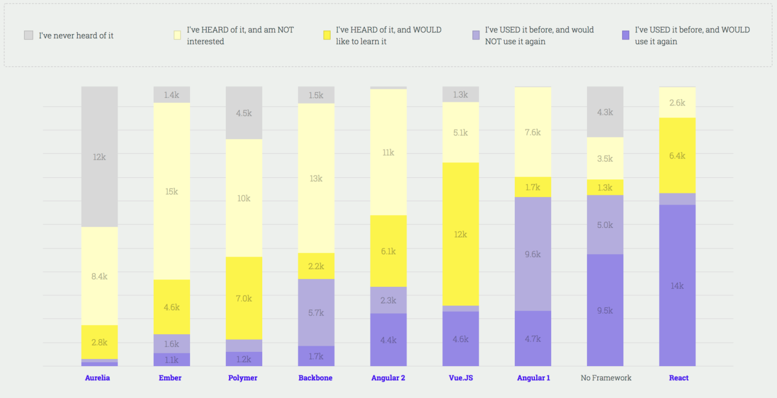
The State of JavaScript Report
Source: https://stateofjs.com/
Notes:
https://insights.stackoverflow.com/survey/2017#technology
https://stateofjs.com/2017/front-end/results/
‘The State of JavaScript’ report is a collection of data from over 20K developers.
There isn't a JavaScript framework that works for everyone. The State of JavaScript report allows us to see what's popular in the front-end world.

Slide 10
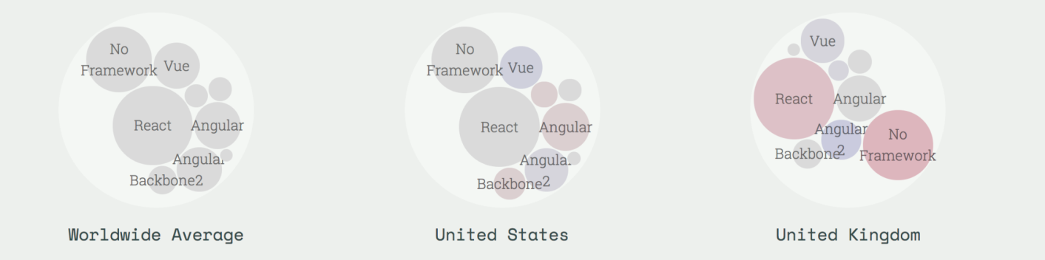
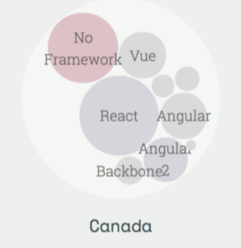
The State of JavaScript – cont.
Notes:
This one is an interesting one as well as it shows the library usage by country.
React seems to dominate the market but Angular and AngularJS do take up a lot of the market share as one of the more popular front-end frameworks used in Canada.

Slide 11
Made with Angular
source: https://www.madewithangular.com/
Notes:
% What companies are using Angular? There are companies made with Angular

Slide 12
Conceptual Overview
Notes:
https://angular.io/guide/architecture
Lets start with the conceptual overview of an Angular application.
Together, a component and template define an Angular view.
A decorator on a component class adds the metadata, including a pointer to the associated template.
Directives and binding markup in a component's template modify views based on program data and logic.
The dependency injector provides services to a component, such as the router service that lets you define navigation among views.
We will cover this more in detail.

Slide 13
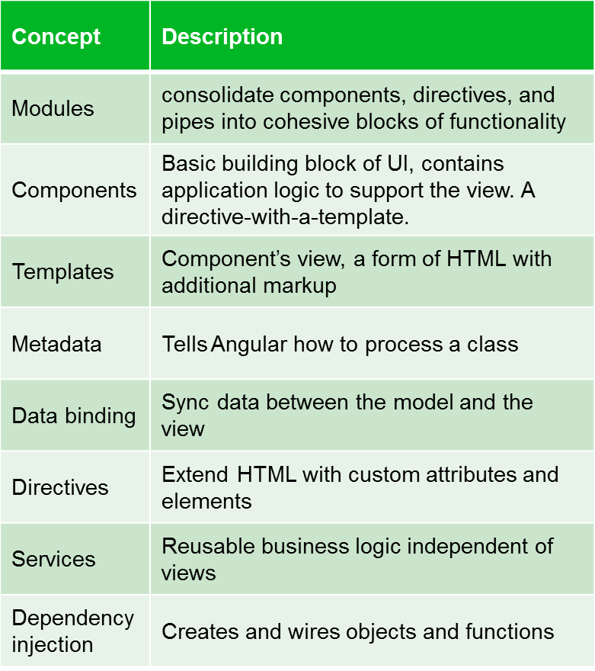
The Main Building Blocks
Notes:
Modules
Angular modules help organize an application into cohesive blocks of functionality.
Components
We can think of our Angular application as a set of components. We create each component, then arrange them to form our application. If all goes well, those components work together in harmony to provide the user with a great experience.
Templates
A template combines HTML with Angular markup that can modify the HTML elements before they are displayed.
Metadata
Metadata is used to decorate a class so that it can configure the expected behavior of the class.
Data Binding
Data binding connects the application data and the document object model(DOM)
Angular supports two-way data binding, meaning that changes in the DOM, such as user choices, can also be reflected back into your program data.
Directives
???
Services
Service is a broad category encompassing any value, function, or feature that an app needs. A service is typically a class with a narrow, well-defined purpose. It should do something specific and do it well.
Dependency Injection
The dependency injector provides services to a component, such as the router service that lets you define navigation among views.
Components consume services; that is, you can inject a service into a component, giving the component access to that service class.

Slide 14
What is an Angular Module?
A class with an NgModule decorator
Its purpose:
  Organize the pieces of our application
  Arrange them into blocks
  Extend our application with capabilities from external libraries
  Provide a template resolution environment
  Aggregate and re-export
Notes:
An Angular module is a class with an NgModule decorator.
Its purpose?
To organize the pieces of our application,
arrange them into cohesive blocks of functionality, and
extend our application with capabilities from external libraries.
Angular modules provide the environment for resolving the directives and pipes in our component's templates.
And modules are a great way to selectively aggregate classes from other modules and re-export them in a consolidated convenience module.
An Angular module can be loaded eagerly when the application starts or it can be lazy loaded asynchronously by the router.

Slide 15
A Basic Use of Modules
import { NgModule } from '@angular/core';
@NgModule({
imports: [],
declarations: [],
bootstrap: []
})
export class AppModule {}
Notes:
To be able to define modules we have to use the decorator NgModule.
In the example, we have turned the class
% AppModule into an Angular module just by using the
% NgModule decorator. The NgModule decorator requires at least three properties: imports, declarations and bootstrap.
% The property imports expects an array of modules.
% The property declarations expects an array of components, directives and pipes that are part of the module.
% The bootstrap property is where we define the root component of our module. Even though this property is also an array, 99% of the time we are going to define only one component.

Slide 16
What are Components?
Angular components are the basic building blocks of your app. Each component defines:
  Any necessary imports needed by the component
  A component decorator, which includes properties that allow you to define the template, CSS styling, animations, etc..
  A class, which is where your component logic is stored.
Angular components reside within the /src/app folder:
  > src
    > app
      app.component.ts
      App.component.html
      App.component.scss

Slide 17
The Basic Component File
import { Component } from '@angular/core';
@Component({
selector: 'app-root',
templateUrl: './app.component.html',
styleUrls: ['./app.component.scss']
})
export class AppComponent {
title = 'app';
}
app.components.ts
Notes:
Want to see what a component looks like? Here is a simple component. It might look complex at first so let's break this component into chunks, starting at the bottom.
% Here is our class. It defines the properties and methods needed by our view.
% Here is the component decorator that defines the metadata. The metadata includes the template that lays out the view managed by this component.
% And here we import the members that we need.

Slide 18
Templates are the View
Templates are mostly HTML, with a little help from Angular. They tell us how to render the Component.
Notes:
Components contain logic, but we still need something to render the page, that's where templates come in.
A template is a form of HTML that tells Angular how to render the component.
Sometimes we just need to give it a little bit of help to know what data to render in a list or maybe how to handle a click event.
Together our HTML with data binding expressions and directives tell Angular how to render the component.

Slide 19
Defining a Template of a Component
Inline Template
template:
`<div>
<h1>{{pageTitle}}</h1>
</div>`
template:
“<h1>{{pageTitle}}</h1>”
templateUrl:
‘./card-list.component.html’
Inline Template
Linked Template
Notes:
% We can use the template property and define an inline template using a simple quoted string with single or double quotes
% We can define an inline template with a multi-line string by enclosing the HTML in ES 2015 back ticks. The back ticks allow composing a string over several lines, making the HTML more readable.
There are some advantages to defining an inline template using one of these two techniques. The template is directly defined within the component, keeping the view and the code for that view in one file. It is then easy to match up our data bindings with the class properties, such as the page title in this example; however, there are disadvantages as well. When defining the HTML in a string, most development tools don't provide IntelliSense, automatic formatting, and syntax checking. Especially as we define more HTML in the template these issues become challenges.
% In many cases, the better option is to define a linked template with the HTML in its own file. We can use the template URL property in the component metadata to define the URL of our HTML file.

Slide 20
Metadata
We use Metadata to tell Angular about the objects we build.
Metadata Links the Template to the Component.
{ }
〈 〉
Metadata
Component
Template
Notes:
There are really are three parts that make a component work,
% there's the component code,
% then there's also the component template, but there's also the third part,
% the metadata.
The metadata is what goes inside those decorators. We're going to use the metadata to tell things to Angular about how to find the component's template. So the metadata is that glue that kind of links those two things together, and it gives Angular information about that component, so it can operate better.

Slide 21
Defining the Metadata
import { Component } from '@angular/core';
@Component({
selector: 'app-root',
templateUrl: './app.component.html',
styleUrls: ['./app.component.scss']
})
export class AppComponent {
title = 'app';
}
app.components.ts
Decorators
The @ is a decorator that provides metadata describing the Component
Component
Component definition class. Controls a patch of screen that we call the view
Notes:
% Here’s an example of our metadata in a component.
% We have a decorator, @Component, right at the top, and this decorates our AppComponent, so the at sign is going to be indicating that it's a decorator and it's going to provide metadata that describes the component right here.
% And the component definition, it's just a class and it's going to be something that controls an area on the screen and we call that the view.
Now there's other things in here too like templates and styles. The templateUrl tells it where to find that HTML in our template syntax and the style URL is plural because it can be an array of different CSS files or SASS or something else you might want to use. And those will all be associated with this component.

Slide 22
Data Binding
We use data binding to help coordinate communication between a Component and its Template.
Interpolation
One Way Binding
Event Binding
{ }
Two Way Binding
DOM
Component
Notes:
One of the most appreciated feature of Angular is data binding.
Let's explore what data binding is and how it works with Angular.
% First we're got a DOM, that's our browser,
% and then we've got a component, our code. And we need to get the data to pass from the component to the DOM and sometimes back. So we have different ways to do this.
% We've got Interpolation, which sends the data one way up to the DOM,
% we also have One Way Binding, which again sends it one way up,
% we have Event Binding so we can talk from the DOM with user actions back to the component, maybe like a click event,
% and then we have Two Way Binding.

Slide 23
Services
A class with a focused purpose.
Used for features that:
Are independent from any particular component
Provide shared data or logic across components
Encapsulate external interactions
Notes:
A service is a class with a focused purpose.
% We often create a service to implement functionality that is independent from any particular component, to share data or logic across components, or encapsulate external interactions such as data access.
By shifting these responsibilities from the component to a service, the code is easier to test, debug, and reuse.
A Service basically provides anything our application needs.

Slide 24
How does it work?
Service
export class myService {}
Component
let svc = new myService{}
SVC
Notes:
Let’s take a look at how services and dependency injection work in Angular.
% In this diagram our service is here
% and our component that needs the service is here.
% There are two ways our component can work with this service.
% The component can create an instance of the service class and use it. That simple and it works, but the instance is local to the component so we can't share data or other resources and it will be more difficult to mock the service for testing.

Slide 25
How does it work?
Injector
SVC
Service
export class myService {}
Component
constructor(private _myService){}
Notes:
Alternatively we can register the service with Angular.
% Angular then creates a single instance of the service class called a singleton and holds onto it. Specifically, Angular provides a built-in injector.
% We register our services with the Angular injector which maintains a container of created service instances. The injector creates and manages the single instance or singleton of each registered service as required.
% If our component needs a service, the component class defines the service as a dependency.
% The Angular injector then provides or injects the service class instance when the component class is instantiated. This process is called dependency injection.
Since Angular manages the single instance, any data or logic in that instance is shared by all of the classes that use it.
This technique is the recommended way to use services because it provides better management of service instances, it allows sharing of data in other resources, and it's easier to mock the services for testing purposes.

Slide 26
Dependency Injection
A coding pattern in which a class receives the instances of objects it needs (called dependencies) from an external source rather than creating them itself.
Notes:
Now let's look at a more formal definition of dependency injection. Dependency injection is a coding pattern in which a class receives the instances of objects it needs, called dependencies, from an external source rather than creating them itself. In Angular this external source is the Angular injector.

Slide 27
Routing
Angular allows our application to navigate between different Components, passing parameters where needed
Notes:
Last thing I would like to talk about before the demo is Routing.
Angular allows us to navigate between viewing component pairs with a router. Routing is how we allow the users to navigate from one point to another.

Slide 28
How Routing Works
Configure a route for each component
Define options/actions
Tie a route to each option/action
Activate the route based on user action
Activating a route displays the component’s view
Notes:
An Angular application is a single page application. That means all of our views are displayed within one page, normally defined in the index.html file. So each of the 5, 10, or 100s of views take turns appearing on that one page.
How do we manage which view to display when?
That's the purpose of routing.
% We configure a route for each component that wants to display its view on the page.
% As part of our application design, we provide a menu, a toolbar, buttons, images, or data links that allow the user to select the view to display.
% We tie a route to each option or action.
% When the user selects the option or performs the action, the associated route is activated.
% Activating a component's route displays that component's view. So for example, the user selects a menu option to display the product list. The product list route is activated and it displays its view.

Slide 29
demonstration

Slide 30
TD Credit Card List
We will create a simple app that covers most of the fundamentals of Angular. (Modules, Components, Templates, Data Binding, Services, Dependency Injection, Routing, and Observable Data)

Slide 31
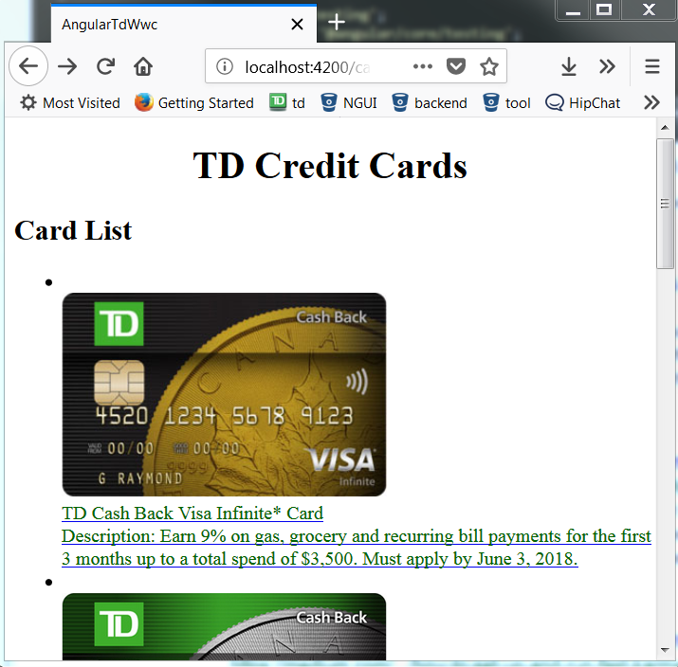
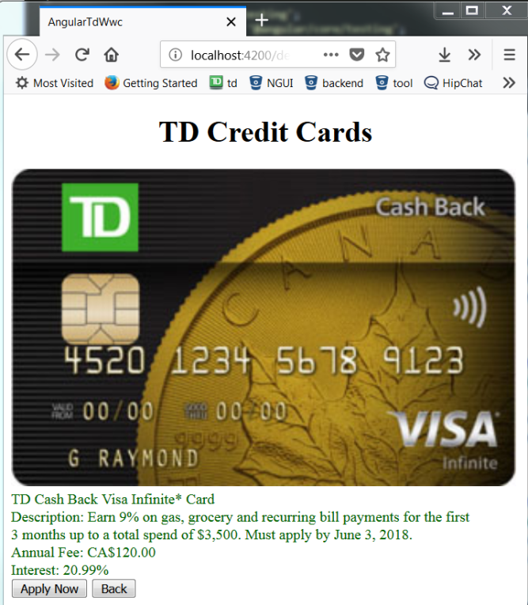
The Credit Cards List App
https://github.com/TDWWC/angular-td-wwc

Slide 32
  Create New Application:
cd into directory where you want to contain the new app
Create new application with Angular CLI command: ng new angular-td-wwc
ng new <project-name> generate a new project with default project structures and supporting files

Slide 33
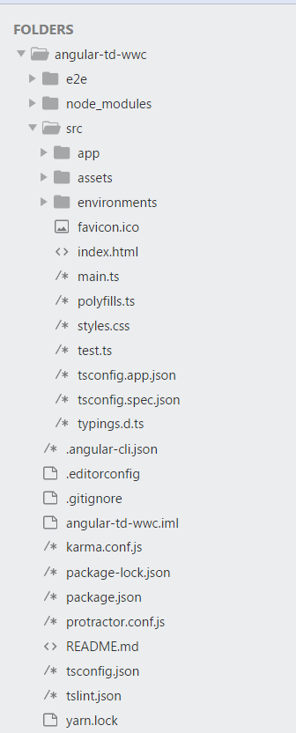
Angular Directory Structure
e2e
Contains end to end tests
node_modules
NPM is the node package manager, which instals packages
locally into this folder
src
Contains the project code, like components, templates, styles
karma.conf.js
unit test configuration file
Protractor.conf.js
end to end test configuration file
package.json
Defines what libraries will be installed into node_modules when you run npm insall

Slide 34
  Serve the Application:
Open up a terminal and cd into your project root directory
Server the application with Angular CLI command: ng serve –open
The above command does the following things:
  Builds the application
  Start the development server
  Watches the source files
  Rebuilds the application when you make changes
  --open flag automatically launches a browser with the default page

Slide 35
  Create New Component
Cd into project root directory
Create a new component named card-list using command: ng generate component card-list
This command creates a new folder, src/app/card-list and generates four files within the folder:
  card-list.component.ts (define and control the view)
  card-list.component.html (define a component's view – template file)
  card-list.component.css (component specific style file)
  card-list.component.spec.ts (define unit test logics, not covered in this tutorial)

Slide 36
Class
Create the component as ES6 Classes
Properties and methods in our component will be available for binding in Template

Slide 37

Class

Slide 38
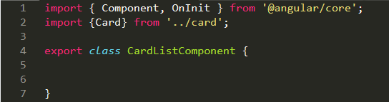
Imports

Slide 39
Decorators
A function that adds metadata to a class, its members (properties, methods) and function arguments.
Common class decorators could be @Component, @Injectable, @Directive etc.
Common member decorators could be @Input, @Output etc.

Slide 40
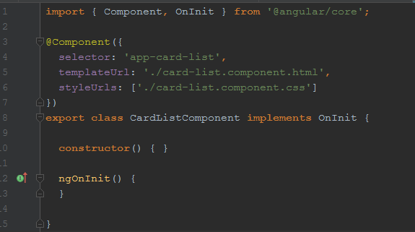
Decorator

Slide 41
Style
Style the card list by copying the following code into card-list.component.css file
https://github.com/TDWWC/angular-td-wwc/blob/master/src/app/card-list/card-list.component.css

Slide 42

  Display Component
To display the card-list component, we need to add it in App Component template file:
  Open app.component.html template file
  Insert card-list element selector <app-card-list></app-card-list> at the end of the file
  View updated content in browser (assume ng serve command is still running)

Slide 43
  Create a Card Class
We will create a Card Class that acts as the blueprints for Card instances we will instantiate later on.
Create a new file called "card.ts" in src/app directory
Copy and paste the following code into card.ts
  export class Card {
  id: number;
  name: string;
  description: string;
  annualFee: number;
  interest: number
  }
Notes:
Talk about the syntax

Slide 44
  Create Mock Data
We will need some Cards to display. In reality, we will get them from a remote data server through HTTP, but for now, we will create some mock data for Cards and pretend they came from the server.
Create a new file called "mock-data.ts" in src/app directory.
Define a CARDS constant as an array and export it
https://github.com/TDWWC/angular-td-wwc/blob/master/src/app/mock-data.ts

Slide 45
  Display Card List
Open card-list component and import mock data CARDS
import { CARDS } from '../mock-data'
Add a Cards property in card-list component class which exposes these cards for binding in HTML template
cards = CARDS;

Slide 46
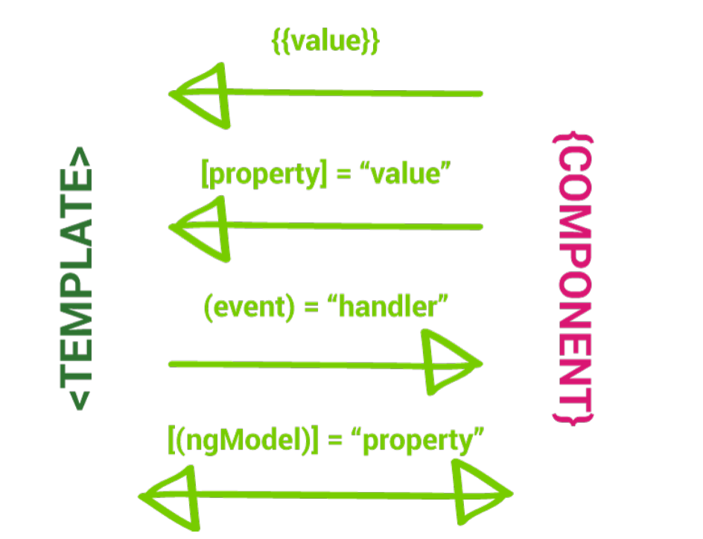
Data Binding

Slide 47
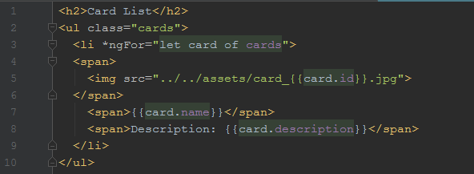
Template
Notes:
List Cards with *ngFor – Angular's repeater directive. It loops through each item with a list. Open card-list.component.html and add the following code

Slide 48
Services
Components shouldn't fetch or save data directly and they certainly shouldn't knowingly present fake data. They should focus on presenting data and delegate data access to a service.
In this tutorial, you'll create a DataService that all application classes can use to get cards. Instead of creating that service with new, you'll rely on Angular dependency injection to inject it into the CardListComponent and CardDetailComponent constructor.

Slide 49
Generating the Service File
Using the Angular CLI, create a service called data:
    ng generate service data --module=app
The command generates skeleton DataService class in /src/app/data.service.ts
@Injectable() services
Notice that the new service imports the Angular Injectable symbol and annotates the class with the @Injectable() decorator.
The @Injectable() decorator tells Angular that this service might itself have injected dependencies. It doesn't have dependencies now but it will soon. Whether it does or it doesn't, it's good practice to keep the decorator.
import { Injectable } from '@angular/core’;
@Injectable()
export class DataService {
constructor(private http: HttpClient) {
}
}

Slide 50
Get Cards data
The DataService could get card data from anywhere—a web service, local storage, or a mock data source.
Removing data access from components means you can change your mind about the implementation anytime, without touching any components. They don't know how the service works.
The implementation in this tutorial will continue to deliver mock cards.
Import the card and CARDS.
import { Card } from './card';
import { CARDS } from './mock-data';

Slide 51
Get Card data – cont.
Add getCards method to return the mock cards.
getCards(): Observable<Card[]> {
return (CARDS);
}

Slide 52

Importing the Service
Each time you generate a service, you need to import and add it to the providers array of the /src/app/app.module.ts file. If you did specify the –module=app parameter when generating the service, add the service manually to the app.module.ts file.

Slide 53
Using the Service in our Components
Open up our /src/app/card-list/card-list.components.ts file and import the service and add it in the constructor via dependency injection:
Next, update the methods beneath the constructor
constructor(private dataService: DataService) { }
getCards(): void {
this.cards = this.dataService.getCards();
}

Slide 54
Routing
We will add a card detail page, so when users click a card in the list, it navigates to a detail view of the selected card.

Slide 55
Card details Component
ng generate component card-detail

Slide 56
Card Detail Component
import {Component, Input, OnInit} from '@angular/core';
import {Card} from "../card";
import {ActivatedRoute} from "@angular/router";
import {Location} from "@angular/common";
import {DataService} from "../data.service";
@Component({
selector: 'app-card-detail',
templateUrl: './card-detail.component.html',
styleUrls: ['./card-detail.component.css']
})
export class CardDetailComponent implements OnInit {
card: Card;
constructor(
private route: ActivatedRoute,
private dataService: DataService,
private location: Location
) { }
ngOnInit() {
this.getCard();
}
getCard(): void{
const id = parseInt(this.route.snapshot.paramMap.get('id'));
this.card = this.dataService.getCardById(id);
}
applyCard(cardName: string): void{
alert(`Congratulation:\n${cardName} is successfully applied!`);
}
goBack(): void{
this.location.back();
}
}

Slide 57
Card Detail template
<div class="card-detail">
<span class="card-detail-row">
<img src="../../assets/card_{{card.id}}.jpg">
</span>
<span class="card-detail-row">{{card.name}}</span>
<span class="card-detail-row">Description: {{card.description}}</span>
<span class="card-detail-row">
<li>Annual Fee: {{card.annualFee | currency:'CAD'}}</li>
<li>Interest: {{card.interest}}%</li>
</span>
<span class="card-detail-row">
<button class="td-button" (click)="applyCard(card.name)">Apply Now</button>
<button class="td-button" (click)="goBack()">Back</button>
</span>
</div>

Slide 58
Routing – Add AppRoutingModule
An Angular best practice is to load and configure the router in a separate, top-level module that is dedicated to routing and imported by the root AppModule.
By convention, the module class name is AppRoutingModule and it belongs in the app-routing.module.ts in the src/app folder.
Use the CLI to generate it
  --flat puts the file in src/app instead of its own folder.
  --module=app tells the CLI to register it in the imports array of the AppModule.
ng generate module app-routing --flat --module=app

Slide 59
Routing – Add AppRoutingModule
The generated file looks like this:
import { NgModule } from '@angular/core';
import { CommonModule } from '@angular/common;
@NgModule({
imports: [
CommonModule
],
declaration: []
})
export class AppRoutingModule { }

Slide 60
Routing – Add AppRoutingModule
Generally we don’t declare components in a routing module, so we can delete the @NgModule.declarations array and delete CommonModule reference too.
You’ll configure the router with Routers in the Route-Module, so import those two symbols from the @angular/router library.
Add an @NgModule.exports array with RouterModule in it. Exporting RouterModule makes routerdirectives available for use in the AppModule.
import { NgModule } from '@angular/core';
import { RouterModule, Routes } from '@angular/router';
@NgModule({
imports: [
RouterModule.forRoot(routes)
],
exports: [
RouterModule
]
})
export class AppRoutingModule { }

Slide 61
Routing – Add Routes
Routes tell the router which view to display when a user clicks a link or pastes a URL into the browser address bar. A typical Route has two properties:
    - path: a string that matches the URL.
    - component: the component that the router should create when navigating to this route.
Import the CardListComponent, CardDetailComponent so you can reference it in a Route. Then define an array of routes with a single route to that component.
You also need to initialize the router and start it listening for browser location changes. This is done by calling RouterModule.forRoot() in the imports array.

Slide 62
Routing – Add Routes
The finished app-routing.module.ts looks like this:
import { NgModule } from '@angular/core';
import { RouterModule, Routes } from '@angular/router';
import { CardListComponent } from './card-list/card-list.component';
import { CardDetailComponent } from './card-detail/card-detail.component';
const routes: Routes = [
{ path: 'cards', component: CardListComponent},
{ path: 'detail/:id', component: CardDetailComponent},
{ path: '', redirectTo: '/cards', pathMatch: 'full' },
];
@NgModule({
imports: [
RouterModule.forRoot(routes)
],
exports: [
RouterModule
]
})
export class AppRoutingModule { }

Slide 63
Routing – Add routerLink to the component
Now, update the card-list.component.html, add the detail link to the individual card row
<ul class="card-list">
<li *ngFor="let card of cards">
<a routerLink="/detail/{{card.id}}">
<div class="card-list-row">
<span class="card-img-col">
<img class="card-list-img" src="../../assets/card_{{card.id}}.jpg">
</span>
<span class="card-description-col">
<p class="card-name">{{card.name}}</p>
<p class="card-description">{{card.description}}</p>
</span>
</div>
</a>
</li>
</ul>

Slide 64
Routing – Add routerLink to the component
Update the card-detail.component.html, add a go back button to the bottom of the template, and bind it to the component’s goBack() method.goBack link to the Back button
<div class="card-detail">
<span class="card-detail-row">
<img src="../../assets/card_{{card.id}}.jpg">
</span>
<span class="card-detail-row">{{card.name}}</span>
<span class="card-detail-row">Description: {{card.description}}</span>
<span class="card-detail-row">
<li>Annual Fee: {{card.annualFee | currency:'CAD'}}</li>
<li>Interest: {{card.interest}}%</li>
</span>
<span class="card-detail-row">
<button class="td-button" (click)="applyCard(card.name)">Apply Now</button>
<button class="td-button" (click)="goBack()">Back</button>
</span>
</div>

Slide 65
Routing – Add routerLink to the component
Add a goBack() method to the card-detial.component.ts class that navigates backward one step in the browser’s history stack using the Location service that you injected previously
import {Component, Input, OnInit} from '@angular/core';
import {Card} from "../card";
import {ActivatedRoute} from "@angular/router";
import {Location} from "@angular/common";
import {DataService} from "../data.service";
@Component({
selector: 'app-card-detail',
templateUrl: './card-detail.component.html',
styleUrls: ['./card-detail.component.css']
})
export class CardDetailComponent implements OnInit {
……
goBack(): void{
this.location.back();
}
}

Slide 66
Routing – Add router-outlet
Now we go to the app.component.html file to replace the <app-card-list> with <router-outlet></router-outlet>
<div style="r">
<h1>
TD Credit Card
</h1>
</div>
<router-outlet></router-outlet>
fsaf

Slide 67

Thank You !
Women Who Code + TD Bank

